Slide 1
Internetworking Concepts
CNA 426/526
Computer Networking II
Dr. Tirthankar Ghosh

Slide 2
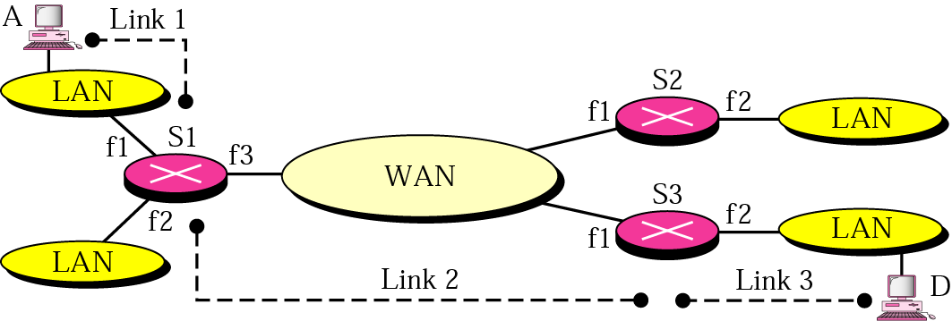
Why is Internetworking Needed?
To ensure data delivery over multiple links in the network.

Slide 3
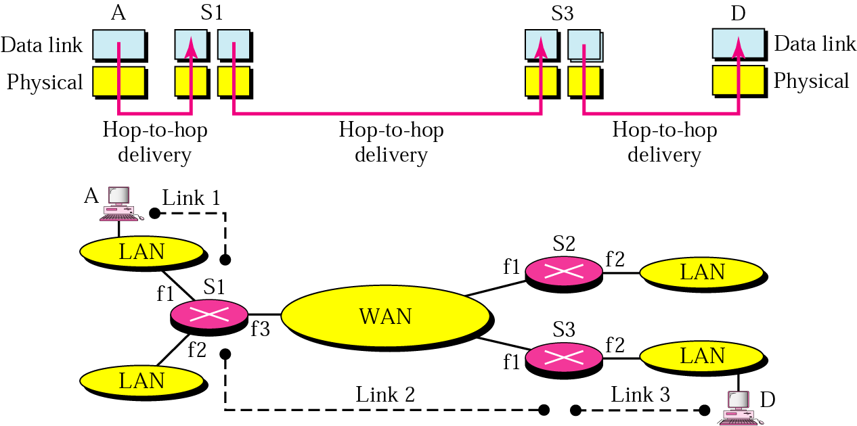
Links in an Internetwork

Slide 4
Why is Internetworking Needed?
LAN having host A does not know what type of data link layer technology the destination LAN is using.
Needs to use a global address.
How does the router know which interface it should send out the data?

Slide 5
Network Layer
Responsible for end to end data delivery over multiple hops (links).
Network layers at source, intermediate router and destination have different functions.

Slide 6
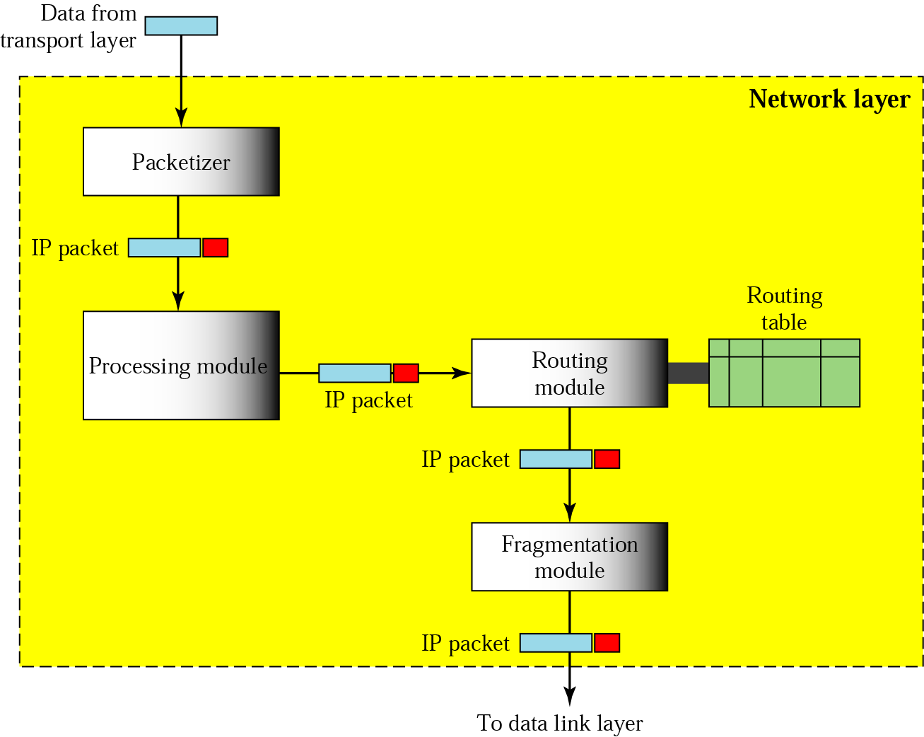
Network Layer at Source

Slide 7
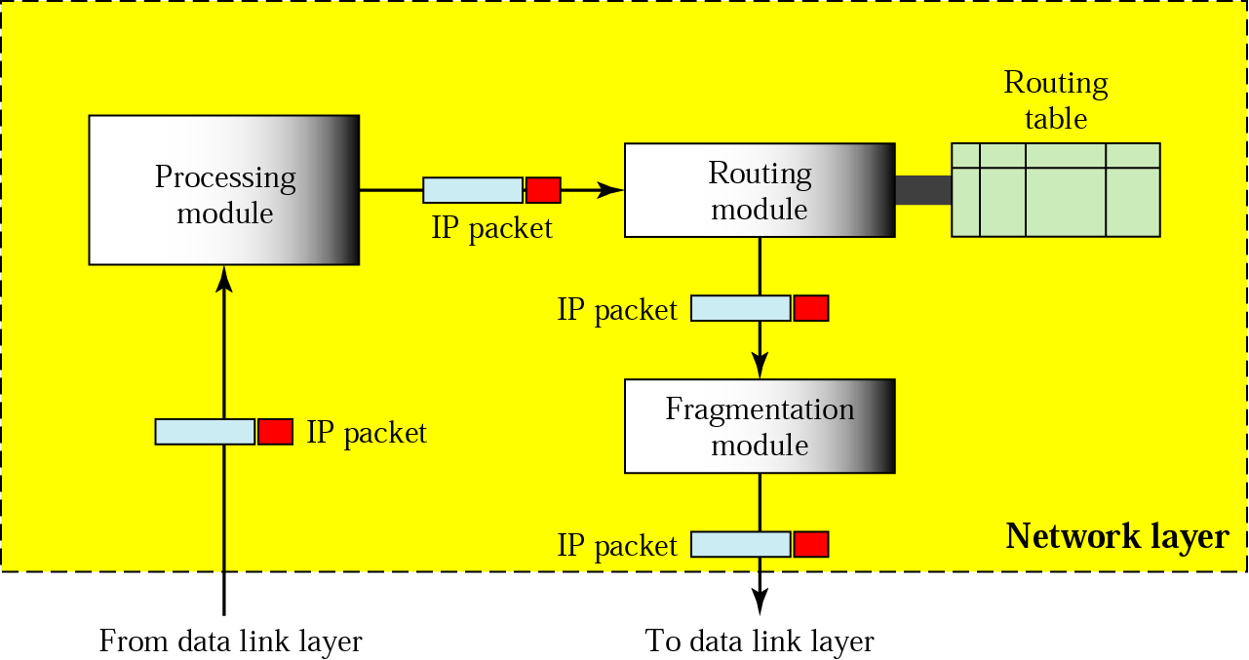
Network Layer at Router

Slide 8
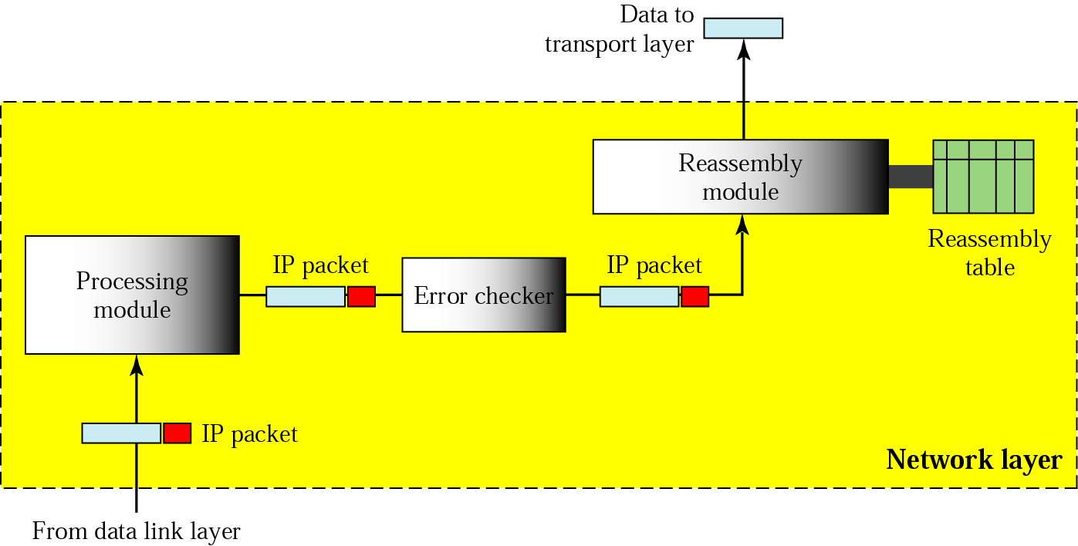
Network Layer at Destination

Slide 9
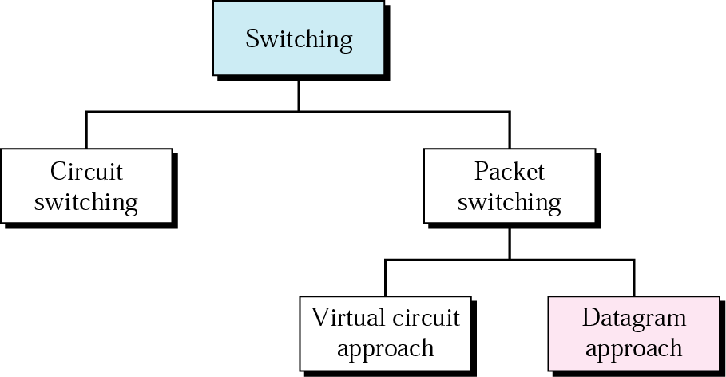
Switching Revisited

Slide 10
Datagram
Each packet is treated independently.
Packets to the same destination may take different paths.

Slide 11
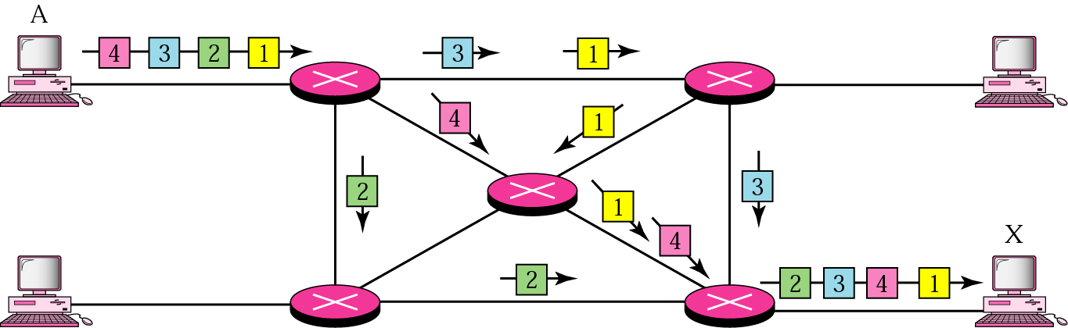
Example Showing Datagram Approach

Slide 12
Concepts of Connection-oriented and Connectionless Services
Connection-oriented Service:
  A connection is set up between the source and destination.
  A sequence of packets is sent, each packet follows the previous and travels through the same path.
  Switches do not have to recalculate the route for each individual packet.
  Example: Virtual Circuit.

Slide 13
Connection-oriented and Connectionless Services (cont’d)
Connectionless Service:
  Each packet is treated independently.
  Each may travel through different path.
  Example: Datagram approach.

